Slide 1


AI-Powered Electricity Price Forecasting

Slide 2

Project Leadership
POURUSH KUMAR GUPTA
Associate Data Scientist
linkedin.com/in/pourush-kumar-gupta-4b1758240

Slide 3

Team Members
AATHISAKTHI G
https://www.linkedin.com/in/aathisakthi-g

Slide 4

Contents
Business Problem
Business Objective & Constraints
Success criteria
Project Architecture
Data collection and details
System Requirements
Data Visualization
Data Preprocessing
Modeling
Evaluation
Result Visualization
Deployment

Slide 5
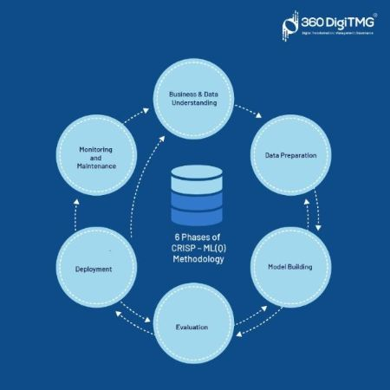
CRISP-ML(Q)
There are six stages of CRISP-ML(Q) Methodology
1.Business and data understanding
2.Data preparation
3.Model building
4.Model evaluation
5.Model deployment
6.Monitoring and maintenance

Slide 6

Business Problem
In power trading, price volatility and demand-supply imbalances create significant financial risks for market participants. Accurately forecasting electricity prices, demand patterns, and renewable energy generation can enhance decision-making for utilities, grid operators, and power traders. The challenge lies in integrating multiple data sources, handling market uncertainties, and optimizing trading strategies in real-time.

Slide 7
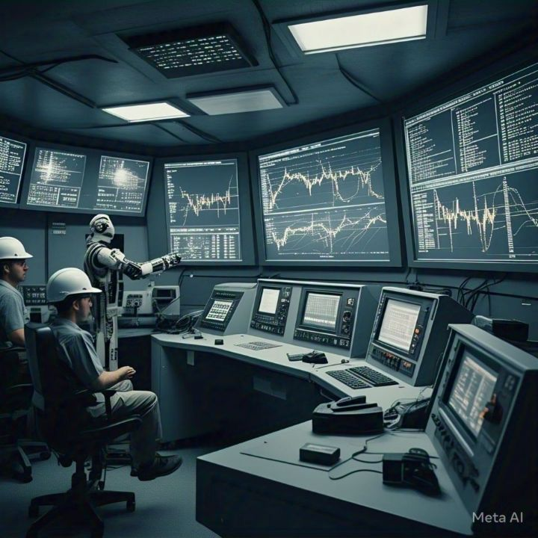

Business Objective:
Minimizing financial risks and procurement costs in power trading.
Business Constraints:
Maximize trading returns

Slide 8

Success Criteria
Business Success Criteria:
ML Success Criteria:
Economic Success Criteria:
At least 15-20% reduction in financial risks due to price volatility, leading to increased profitability for power traders and utilities.
Achieving a Mean Absolute Percentage Error (MAPE) below 10% compared to baseline models
Optimized trading strategies leading to 5-10% savings in energy procurement costs and a 10-15% increase in returns frompowertrading.

Slide 9
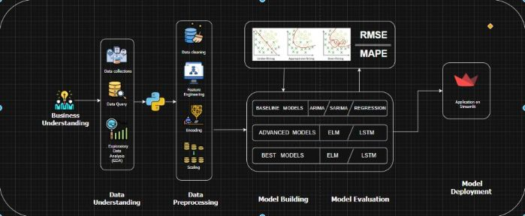
Project Overview and Scope

Slide 10
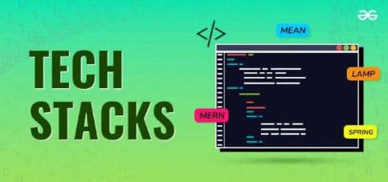
Technical Stacks
1. Programming Language & Libraries:
-- Python (Primary language)
-- NumPy, Pandas, sklearn (Data handling)
-- Tensorflow
-- pickle, Joblib
2. SQL Tools:
-- SQL Alchemy
-- Urllib
3. Model & Frameworks:
-- Model Based Approaches
-- Data Based Approaches
-- ARIMA
-- LASSO, Ridge, ElasticNet, Bayesian Ridge
-- LSTM
-- XGB
-- Random Forest
4. Training :
-- Google Colab (GPU)(Training environment)
-- Vscode(CPU)
5. Evaluation Metrics:
-- MAPE(Mean Absolute Persentage Error)
-- RMSE(Root Mean Squared Error)
6. Visualization Tools:
-- Matplotlib/Seaborn : for plotting results and metrics
7. Deployment:
-- Streamlit(web app for real-time inference)

Slide 11
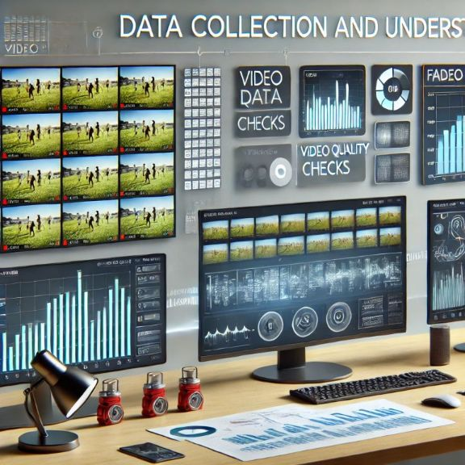
Data Collection and Understanding
Introduction to Data Collection:
Purpose: To train for models taken Data is a structed. Dataset conatains 75,700 records and 7 columns(Datetime, Session ID, Purchase Bid(MW), Sell Bid (MW),MCV (MW), Final Scedule Volume (MW), MCP(Rs/MWh)).Data ranges from 2023-01-01-00-00-00 to 2025-02-27-13-15-00 and having 15 Min interval
Data Sources: Google , IEX website.
2. Data collection Methods:
Manual Collection: collecting importand features based on business problem
Online Datasets: Using IEX website.
Synthetic Data: Generating data using AI.
3. EDA (Exploratory Data Analysis)
Joblib - Auto EDA
DTale - Auto EDA
Time series Analysis
ACF & PACF Plots

Slide 12
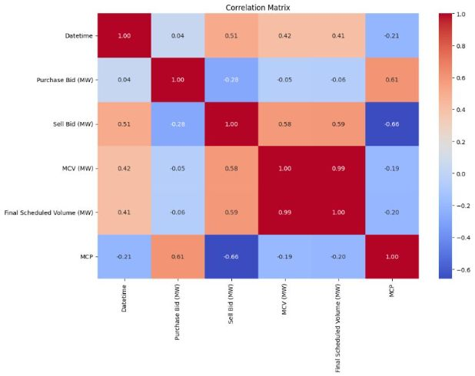
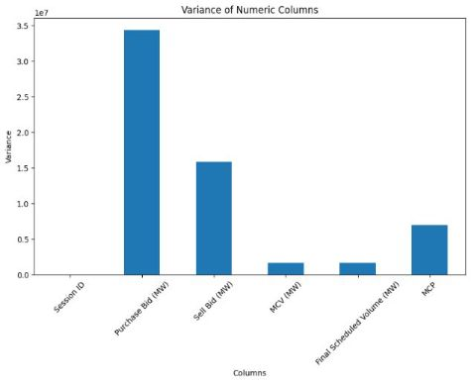
Data Visualization

Slide 13
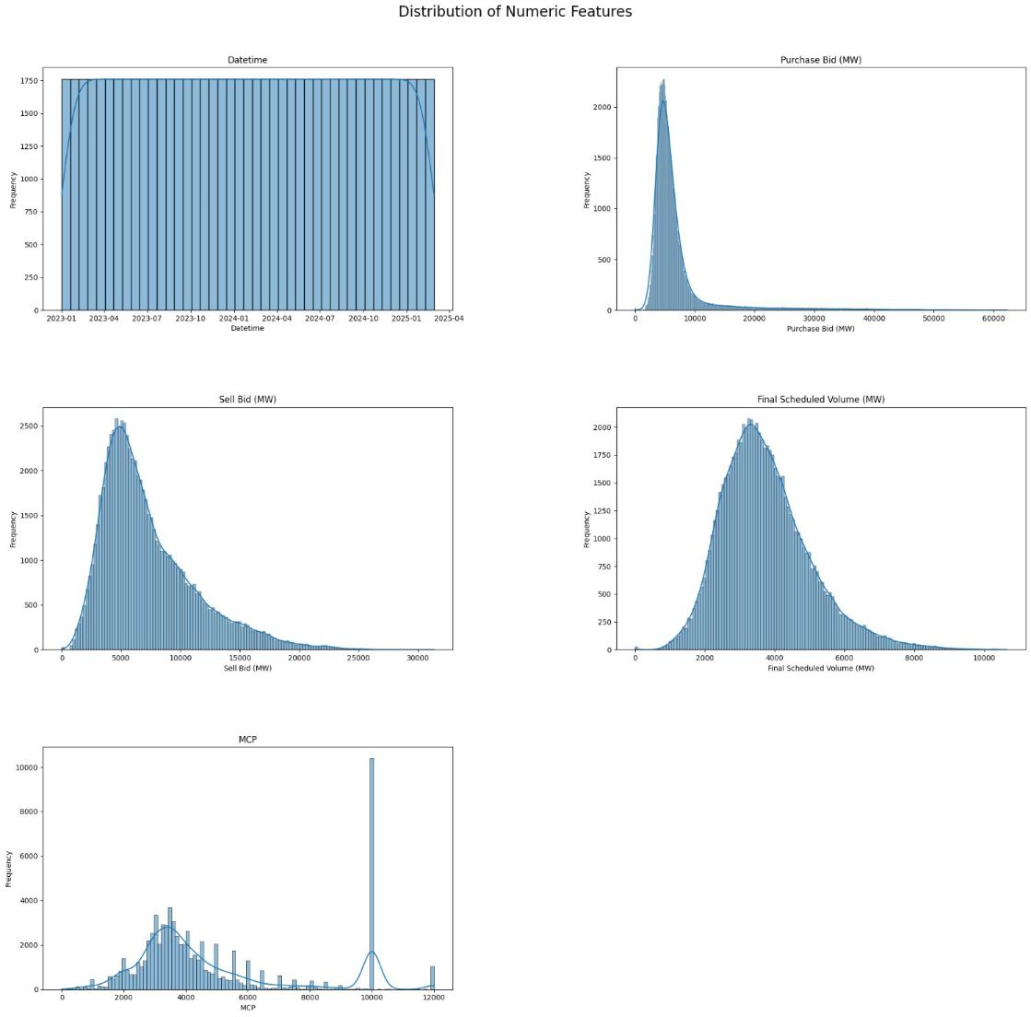
Data Visualization

Slide 14
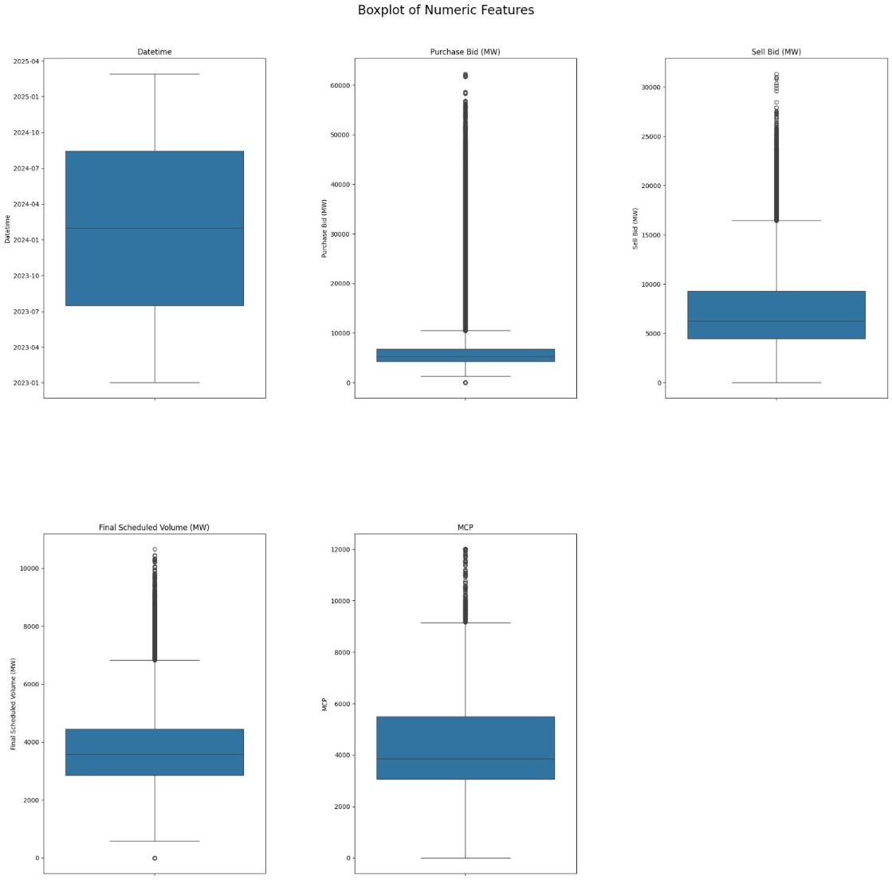
Data Visualization

Slide 15
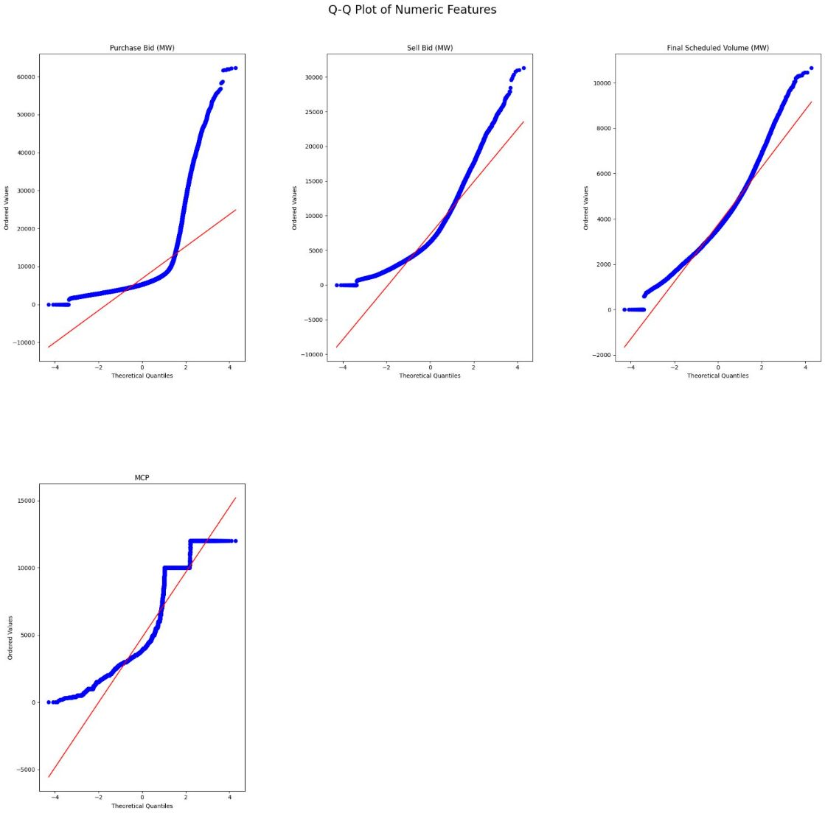
Data Visualization

Slide 16
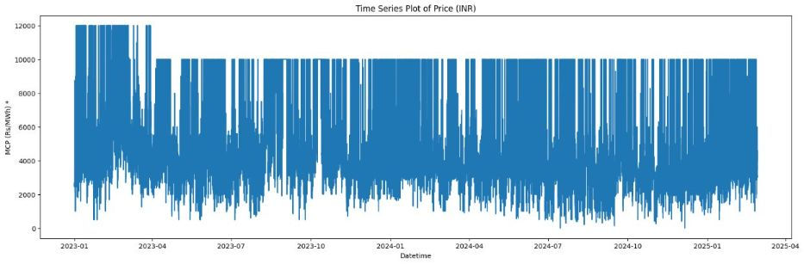
Data Visualization

Slide 17
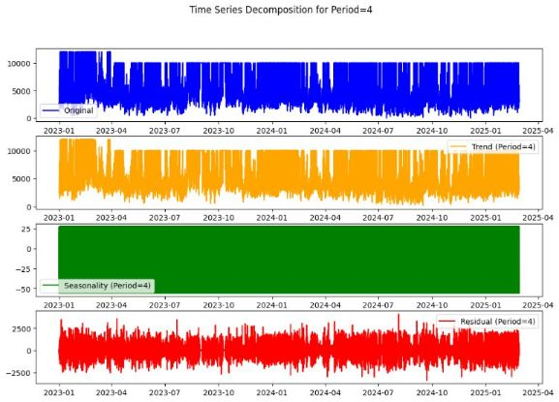
Data Visualization

Slide 18
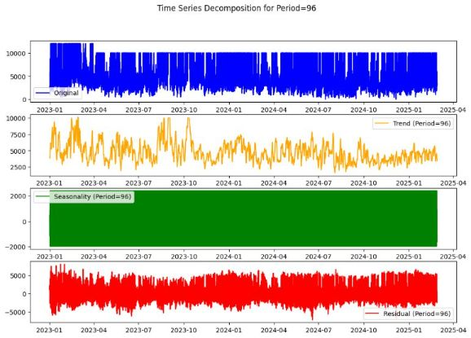
Data Visualization

Slide 19
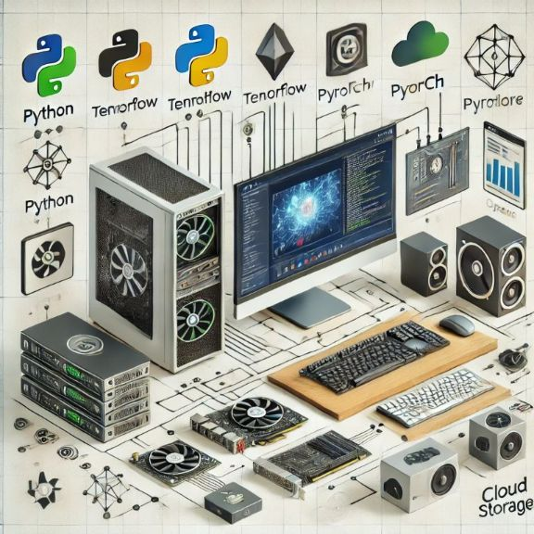
System Requirements
Hardware Requirements:-
For Training (Google Colab / Local GPU Server)
GPU: NVIDIA RTX 3090 / A100 / V100 (Recommended for faster training)
CPU: Intel i7 / Ryzen 7 or higher (if using local training)
RAM: 16GB+ (32GB recommended for large datasets)
Storage: 100GB+ SSD (More space needed for datasets and model checkpoints)
Internet: High-speed connection for dataset uploads and cloud access
# Plotting and visualization
plotly==5.24.1
# Jupyter Notebook
jupyter==1.0.0
# Database connection
sqlalchemy==2.0.34
# Additional libraries used in the project
dtale==3.14.1
pymysql==1.1.1
# Hyperparameter Tuning
optuna==4.2.1
matplotlib==3.9.1
seaborn==0.13.2
# Time series analysis
statsmodels==0.14.2
scipy==1.14.1
pmdarima==2.0.4
Software Requirements :-
OS:
Windows 10+
Libraries & Dependencies:-
# Basic libraries
numpy==1.26.4
pandas==2.2.2
# Machine learning
scikit-learn==1.5.1
Streamlit: For model deployment

Slide 20
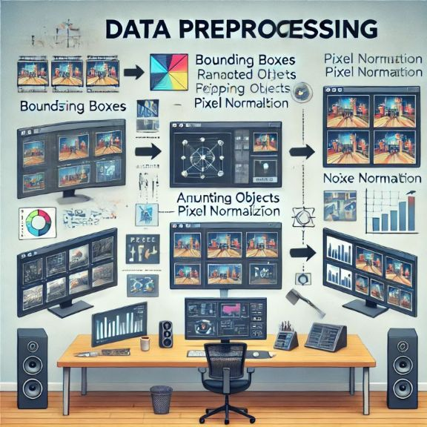
Data Preprocessing
Data Preprocessing:
Imputation: Handling Null Values and Zero Values
Feature engineering- lag of 96(1day)
Feature Scaling - Robust scaling, Standard Scaling
Data Quality & Challenges:
More fluctations and volatality presence, noisy data
Train-Test-Validation Split:
Training(Upto end of 2024) remaining Testing is 5,526 rows (Staring of 2025).

Slide 21

Model Building
Model Based Approaches
Data Based Approaches
ARIMA
SARIMA
LASSO,
Ridge
ElasticNet,
Bayesian Ridge
LSTM
XGB
Random Forest

Slide 22
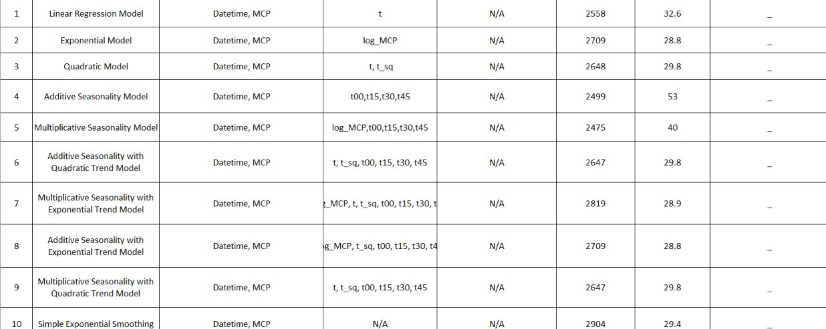
Result and accuracy of models

Slide 23
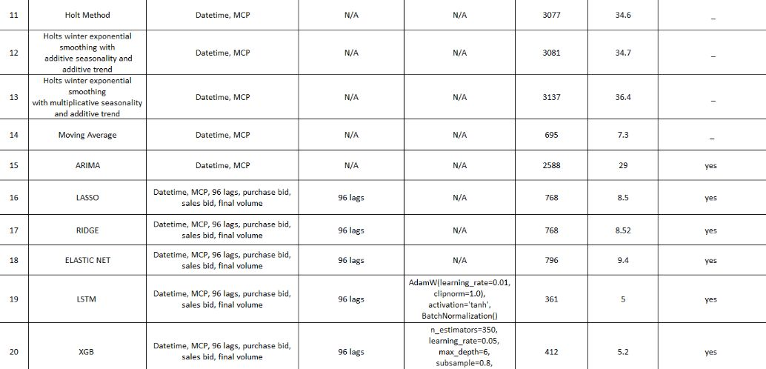
Result and accuracy of models

Slide 24
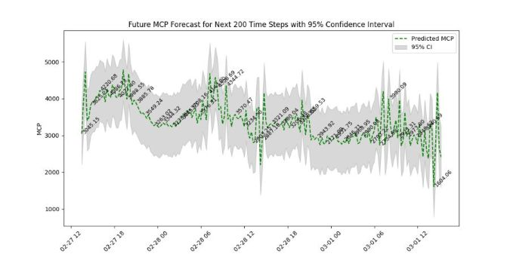
Result Data Visualization OF XGB

Slide 25
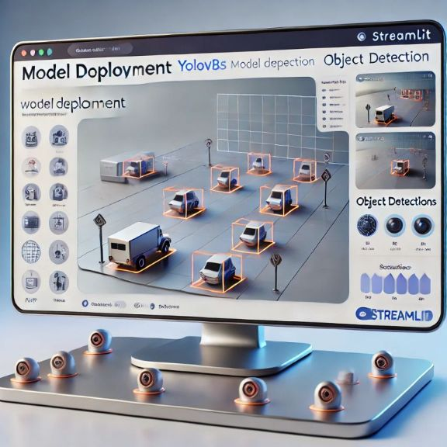
Model Deployment - Strategy
To ensure seamless accessibility and user interaction, the streamlit app can be prepared
Key points added in streamlit:-
User Database Credentials
Raw excel or CSV file to upload
Confidence Interval of forecasted values (90%, 95%, 99%)
How many Forecasted values we do forecast, that option will added
Predict allocated to forecast future values
plot is displayed for forecasted values
forecasted data along with its confidence values displayed in tabular format
Save that table to database
Retrain the model in streamlit itself

Slide 26
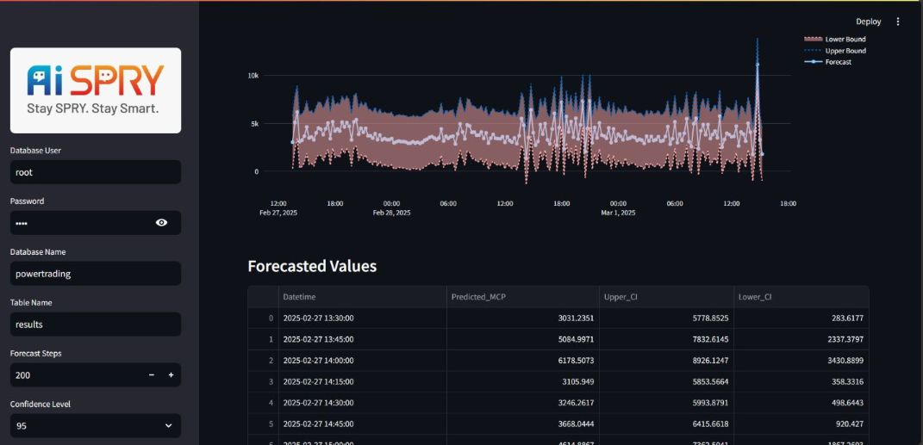
Screen shots of output

Slide 27
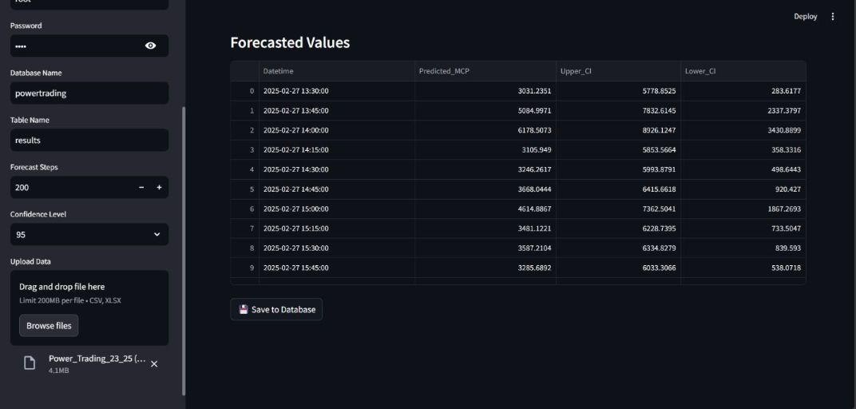
Screen shots of output

Slide 28
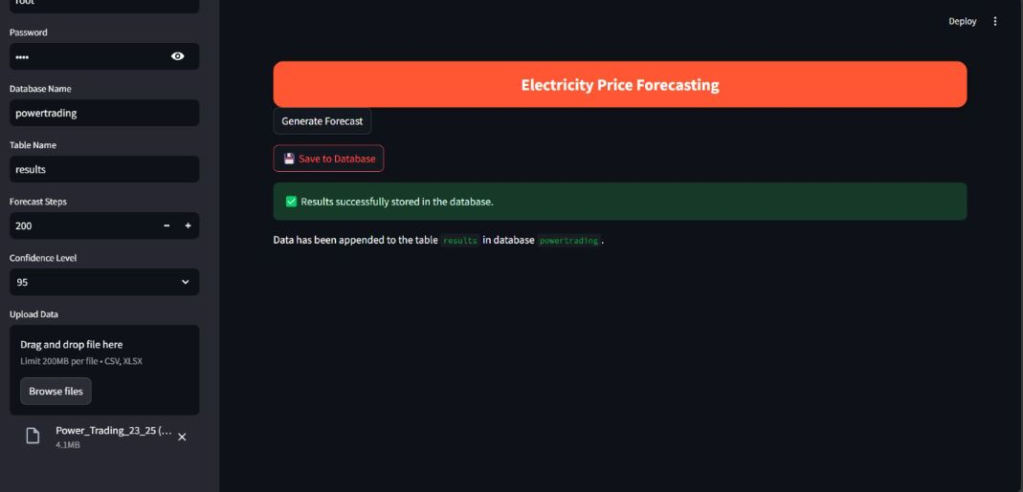
Screen shots of output

Slide 29
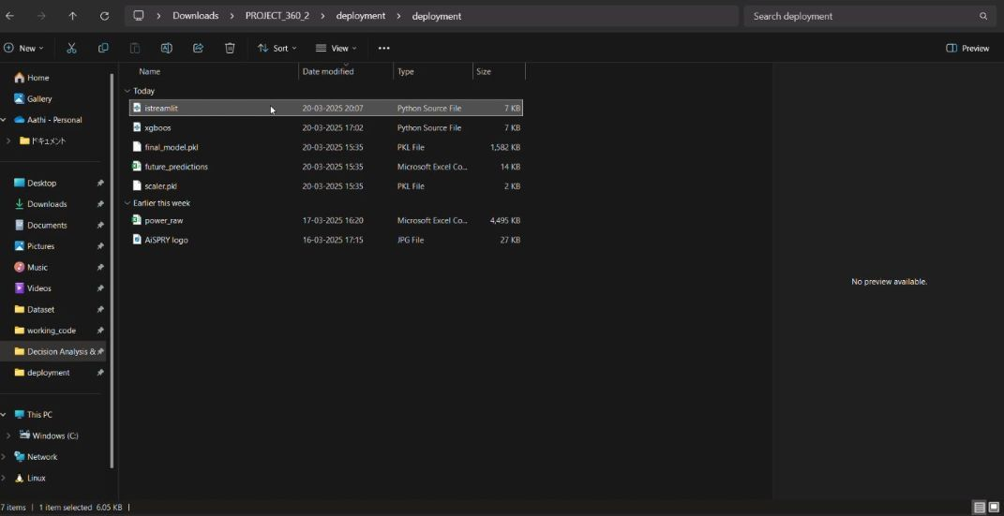
Video of output

Slide 30

Queries ?

Slide 31


